Slide 1
Dormitory Authority
of the
State of New York
We Finance, Design & Build New York's Future

Slide 2
Agenda
About DASNY
Job Order Contract Program Overview
What are Job Order Contracts (JOCs)?
Job Order Contract Program Overview
Solicitation & How to Bid an Adjustment Factor
Solicitation & Form of Bid
Construction Task Catalog® & Adjustment Factor
Calculating Adjustment Factors
Opportunity Programs Requirements
Contract Execution Requirements for Apparent Low Bidders
Regions & Schedule of Events
Questions

Slide 3
About DASNY Construction
New York State's public finance and construction authority
75+ Years of Building New York State
Completed 1000+ projects since its inception
Clients: public and private colleges, hospitals, primary care facilities, psychiatric centers, laboratories, etc.

Slide 4
Job Order Contract Program Overview

Slide 5
What are Job Order Contracts (JOCs)?
Fast delivery method for construction projects
Construction Term Contract
Base term: one (1) year with three (3) one (1) year option periods – Potentially a four (4) year contract
Award multiple contracts in each region
Work is assigned based on Client’s needs & Project scope

Slide 6
What are Job Order Contracts (JOCs)?
Estimated Annual Contract Volume (EACV)
Not guaranteed to receive this volume of work
The Minimum Contract Value = $0
Project Labor Agreements apply to Regions 1-3

Slide 7
Job Order Contract Program Overview
Definition
Indefinite delivery/indefinite quantity process (IDIQ)
Enable contractors to complete a substantial number of individual projects with a single bid
Price Proposals (estimates) are built using the Custom DASNY Construction Task Catalog, with preset unit prices (LME) for in place construction - available in the eGordian estimating software
Awarded Contracts based on lowest responsive, responsible bidder
Saves time & money for DASNY to Procure Construction Projects
Provides transparency and auditability for DASNY
Value

Slide 8
JOC Overview: Umbrella Contract

Slide 9
JOC Overview: The JOC - 5 Step Process
DASNY schedules a Joint Scope meeting on site with all stakeholders to discuss project scope of work and design details.
DASNY prepares a Detailed Scope of Work that defines
the work to be performed and sends contractor a RFP.
The JOC Contractor builds a Price Proposal in eGordian by selecting the appropriate tasks from the Construction Task Catalog ® (CTC)
DASNY Reviews the Price Proposal to ensure the JOC Contractor has selected the appropriate tasks, quantities and factor.
Upon approval of a Price Proposal Package - DASNY issues a Lump Sum Job Order to complete the Detailed Scope of Work.

Slide 10
Bonding Requirements
Performance and Payment Bonds
Surety Letter attesting to overall & per project bonding limits
Apparent Low Bidder’s aggregate bonding capacity $≥$ Estimated Annual Contract Volume

Slide 11
Solicitation & How to Bid an Adjustment Factor

Slide 12
Solicitation
REGION (S) | TRADE | CR # | ESTIMATED ANNUAL CONTRACT VOLUME (PER CONTRACT YEAR) | # OPTIONS
1 | General Construction | 619 | $1,500,000.00 | 3
4 | HVAC | 620 | $500,000.00 | 3
4 | Plumbing | 621 | $500,000.00 | 3
7 | General Construction | 622 | $500,000.00 | 3
8 | General Construction | 623 | $500,000.00 | 3
9 | Electrical | 624 | $500,000.00 | 3
10 | Electrical | 625 | $500,000.00 | 3
10 | General Construction | 626 | $500,000.00 | 3

Slide 13
Form of Bid
Form of Bid - PLA (Regions 1-3)
Form of Bid - Non-PLA (Regions 4-10)

Slide 14
Form of Bid -Award is Based on Award Criteria Figure
Regions 4-10 Must Bid Four (4) Adjustment Factors Regions 1-3 Must Bid Eight (8) Adjustment Factors
NON-PLA WORK : NON-PLA WORK:
Normal Working Hours Normal Working Hours
Other Than Normal Working Hours Other Than Normal Working Hours
ALL WORK Non-Pre-Priced Work ALL WORK Non-Pre-Priced Work
PLA WORK:
Day Shift (Monday –Friday)
Night Shift (Monday-Friday)
Day Shift (Saturday or Sunday)
Night Shift (Saturday or Sunday)
Holidays
NOTE: Please read the bid Form for requirements for each adjustment factor

Slide 15
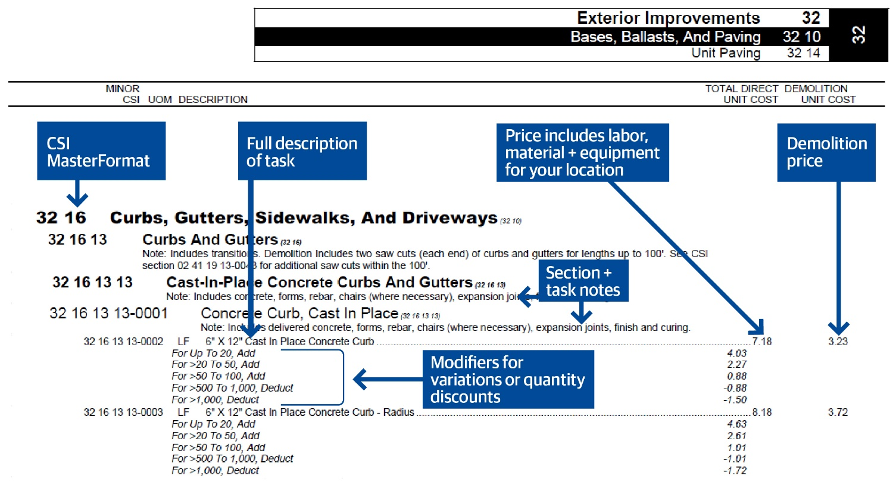
Construction Task Catalog ®

Slide 16
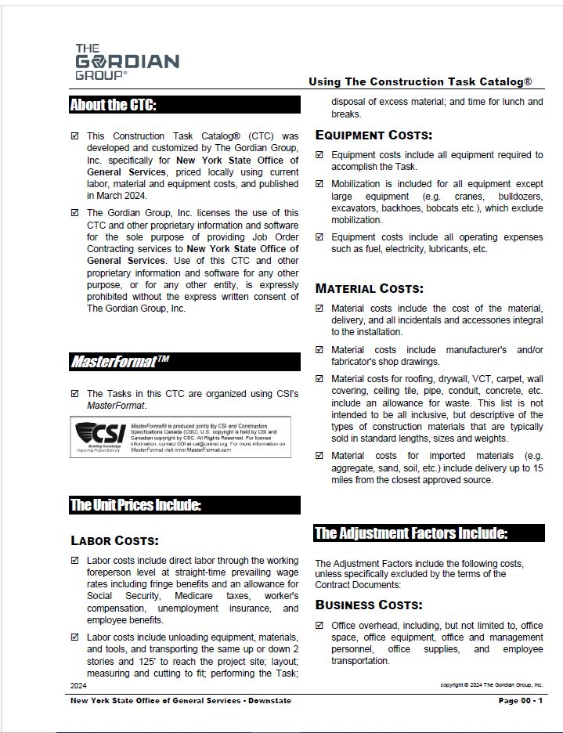
Construction Task Catalog®
Using Construction Task Catalog
THE BIG NOTE - first 6 pages:
Contractor MUST review and understand the “Using the Construction Task Catalog®” document
These are the “Rules of the Game”
Make sure you get paid for all appropriate tasks
Pages 00 – 1 to 00-6 of the CTC.
Located after the Table of Contents of the Unit Price Book as well as the JOC Construction Contract Volume 1

Slide 17
Calculating the Adjustment Factors
2. Create a Representative Project
Create a Scope of Work
Get Sub Quotes or Estimate Cost
Price Project From Unit Price Book
Add Overhead and Profit
Calculate the Adjustment Factor
1. Use Historical Project Data
Select a Completed Project
(You Know Scope and Direct Costs)
Price Project From the Construction Task Catalog (Unit Price Book)
Add Overhead and Profit
Calculate the Adjustment Factor

Slide 18
Calculating the Adjustment Factors
Overhead Costs
Job Order Development
Initial Joint Scope Meetings
Additional Follow-up Site Visits, subs, suppliers, etc.
Reviewing Detailed Scopes of Work
Building Acceptable Price Proposal Packages
Full-Time Supervision and Management
Safety Plan
Bonds & Insurance
Vehicles
Home Office Support
Communications
Putting It All Together
Cost of Work, Quotes or Estimates = $ 82,698.00
Overhead @ 10% = $ 8,269.80
Subtotal = $ 90,967.80
Profit @ 5% = $ 4,548.39
Total = $ 95,515.39
Recall: Price Proposal from CTC® $ 82,127.40
$95,515.39 / $82,127.40 = Adjustment Factor
Adjustment Factor = 1.1630*
*Sample Only. Contractor to determine O/H & Profit.
Prepare this calculation for more than one sample project.

Slide 19
Opportunity Programs Requirements
REGION | TRADE | CR# | MBE % | WBE % | SDVOB % | EEO %
1 | General Construction | 619 | 18% | 12% | 6% | 45%
4 | HVAC | 620 | 18% | 12% | 6% | 10%
4 | Plumbing | 621 | 18% | 12% | 6% | 10%
7 | General Construction | 622 | 18% | 12% | 6% | 10%
8 | General Construction | 623 | 18% | 12% | 6% | 10%
9 | Electrical | 624 | 18% | 12% | 6% | 10%
10 | Electrical | 625 | 18% | 12% | 6% | 15%
10 | General Construction | 626 | 18% | 12% | 6% | 15%

Slide 20
Contract Execution Requirements for Apparent Low Bidders
Minimum Qualifications Form
Insurance
New York State Vendor Responsibility Questionnaire
Agreement
Surety Letter

Slide 21
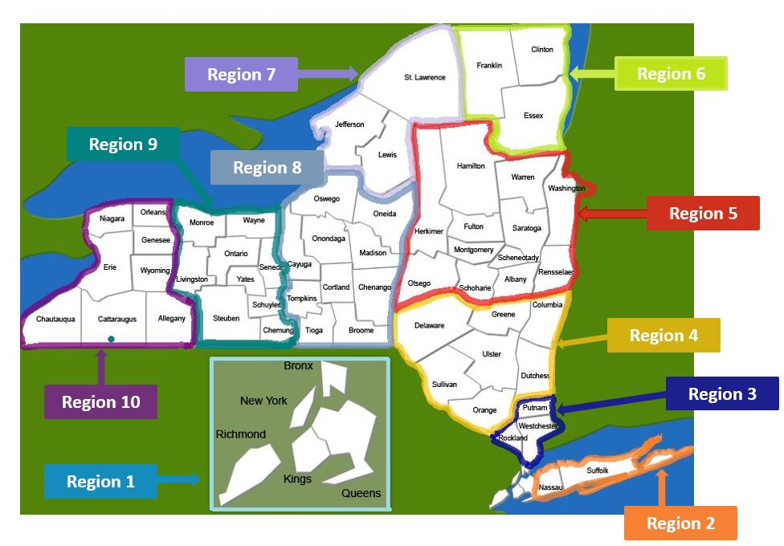
DASNY’s Job Order Contracting Regions
DASNY's JOC REGIONS
Region | Counties Included
1 | New York (Manhattan), Bronx, Kings (Brooklyn), Richmond (Staten Island), and Queens
2 | Nassau, and Suffolk
3 | Westchester, Rockland, and Putnam
4 | Orange, Sullivan, Delaware, Ulster, Dutchess, Greene, and Columbia
5 | Rensselaer, Albany, Schenectady, Otsego, Schoharie, Fulton, Montgomery, Saratoga, Washington, Warren, Hamilton, and Herkimer
6 | Essex, Clinton, and Franklin
7 | Lewis, Jefferson, and St. Lawrence
8 | Broome, Tioga, Tompkins, Cortland, Chenango, Cayuga, Onondaga, Madison, and Oswego
9 | Monroe, Wayne, Livingston, Ontario, Seneca, Yates, Steuben, Schuyler, and Chemung
10 | Niagara, Orleans, Genesee, Erie, Wyoming, Chautauqua, Allegany, and Cattaraugus

Slide 22
Schedule of Events
DATE | EVENT
November 8, 2024 | Advertise Contracts (all regions)
December 4, 2024, at 10:00 AM | Pre-Bid Meeting for Prospective Bidders held via Zoom
December 8, 2024 | RFIs due
December 18, 2024, at 2:00 PM | Bids received by, opened, and read aloud

Slide 23
Questions?

